Slide 1
AI Cowboys in the Clinical Wild West
Alexander Gibson
www.alexdgibson.com ad.gibson@hdr.qut.edu

Slide 2
Clinical Prediction Models
Outcome
  Diagnostic or Prognostic
Method
  Logistic regression, Random Forest, XGBoost
Data
  Routinely collected, retrospective
Study Type
  Development, internal/external validation, randomised trial

Slide 3
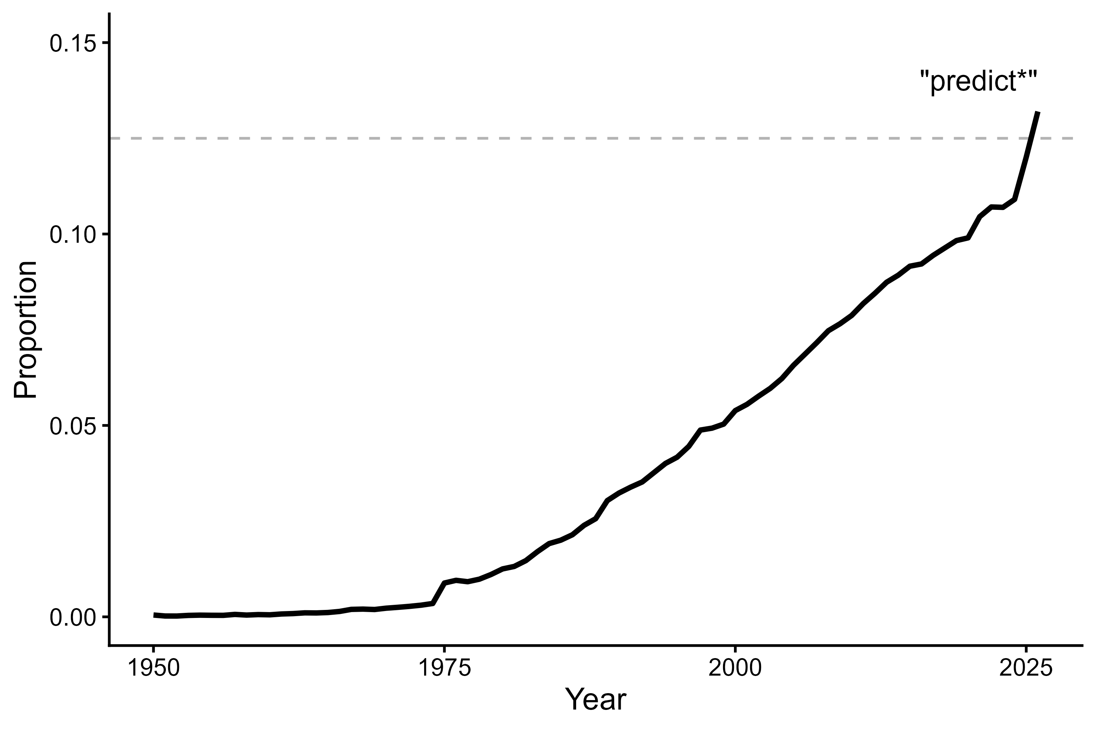

Slide 4
APGAR Score

Slide 5
Commercialisation of computers
APGAR Score

Slide 6
Commercialisation of AI
Commercialisation of computers
APGAR Score

Slide 7
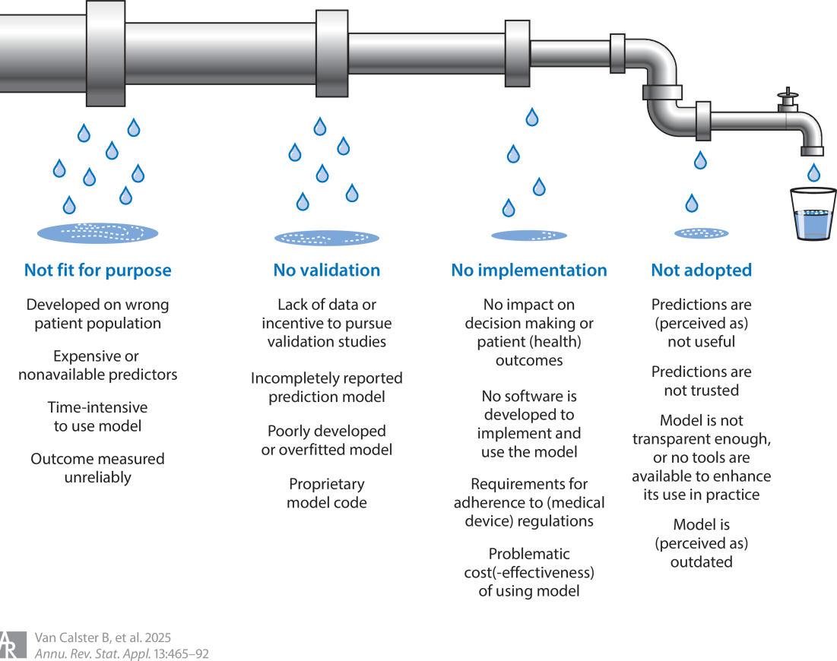
Plagued with Poor Practice
https://doi.org/10.1146/annurev-statistics-042324-123749

Slide 8
Data Provenance
Who What When Where Why How

Slide 9
“Data provenance is the documentation of where a piece of data comes from and the processes and methodology by which it was produced. Put simply, provenance answers the questions of why and how the data was produced, as well as where, when and by whom.
Data provenance is metadata that confirms the authenticity of that data and enables it to be reused.”
- Australian Research Data Commons https://ardc.edu.au/resource/data-provenance/

Slide 10
“Data provenance is the documentation of where a piece of data comes from and the processes and methodology by which it was produced. Put simply, provenance answers the questions of why and how the data was produced, as well as where, when and by whom.
Data provenance is metadata that confirms the authenticity of that data and enables it to be reused.”
- Australian Research Data Commons https://ardc.edu.au/resource/data-provenance/

Slide 11


Slide 12



Slide 13




Slide 14

https://doi.org/10.1186/s12916-026-04981-y

Slide 15
Diabetes and Stroke Data
No data provenance recorded for either dataset

Slide 16
Findings
125 prediction model articles
86 review articles
32 countries
3 potentially used on patients
1 medical device patent
0 information

Slide 17
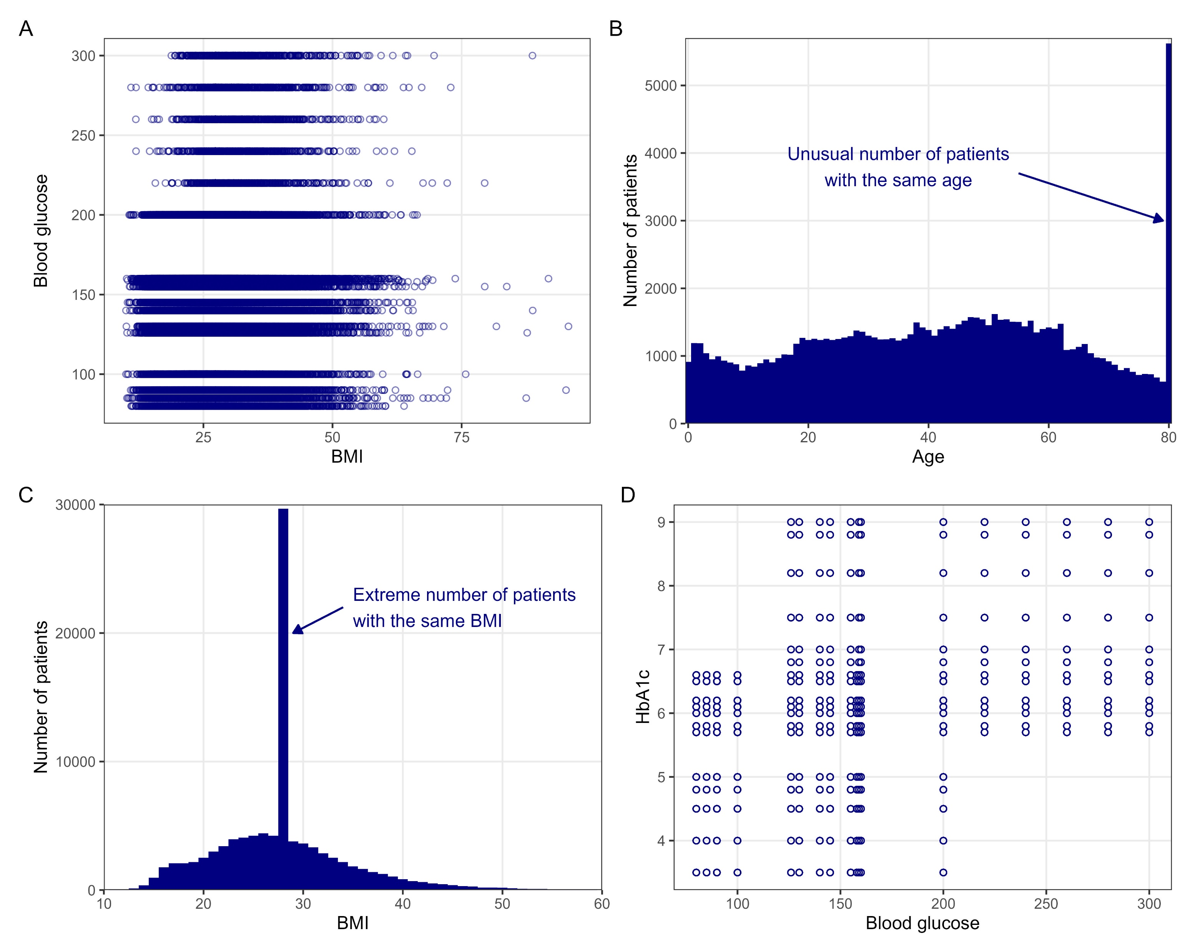
Diabetes Dataset

Slide 18
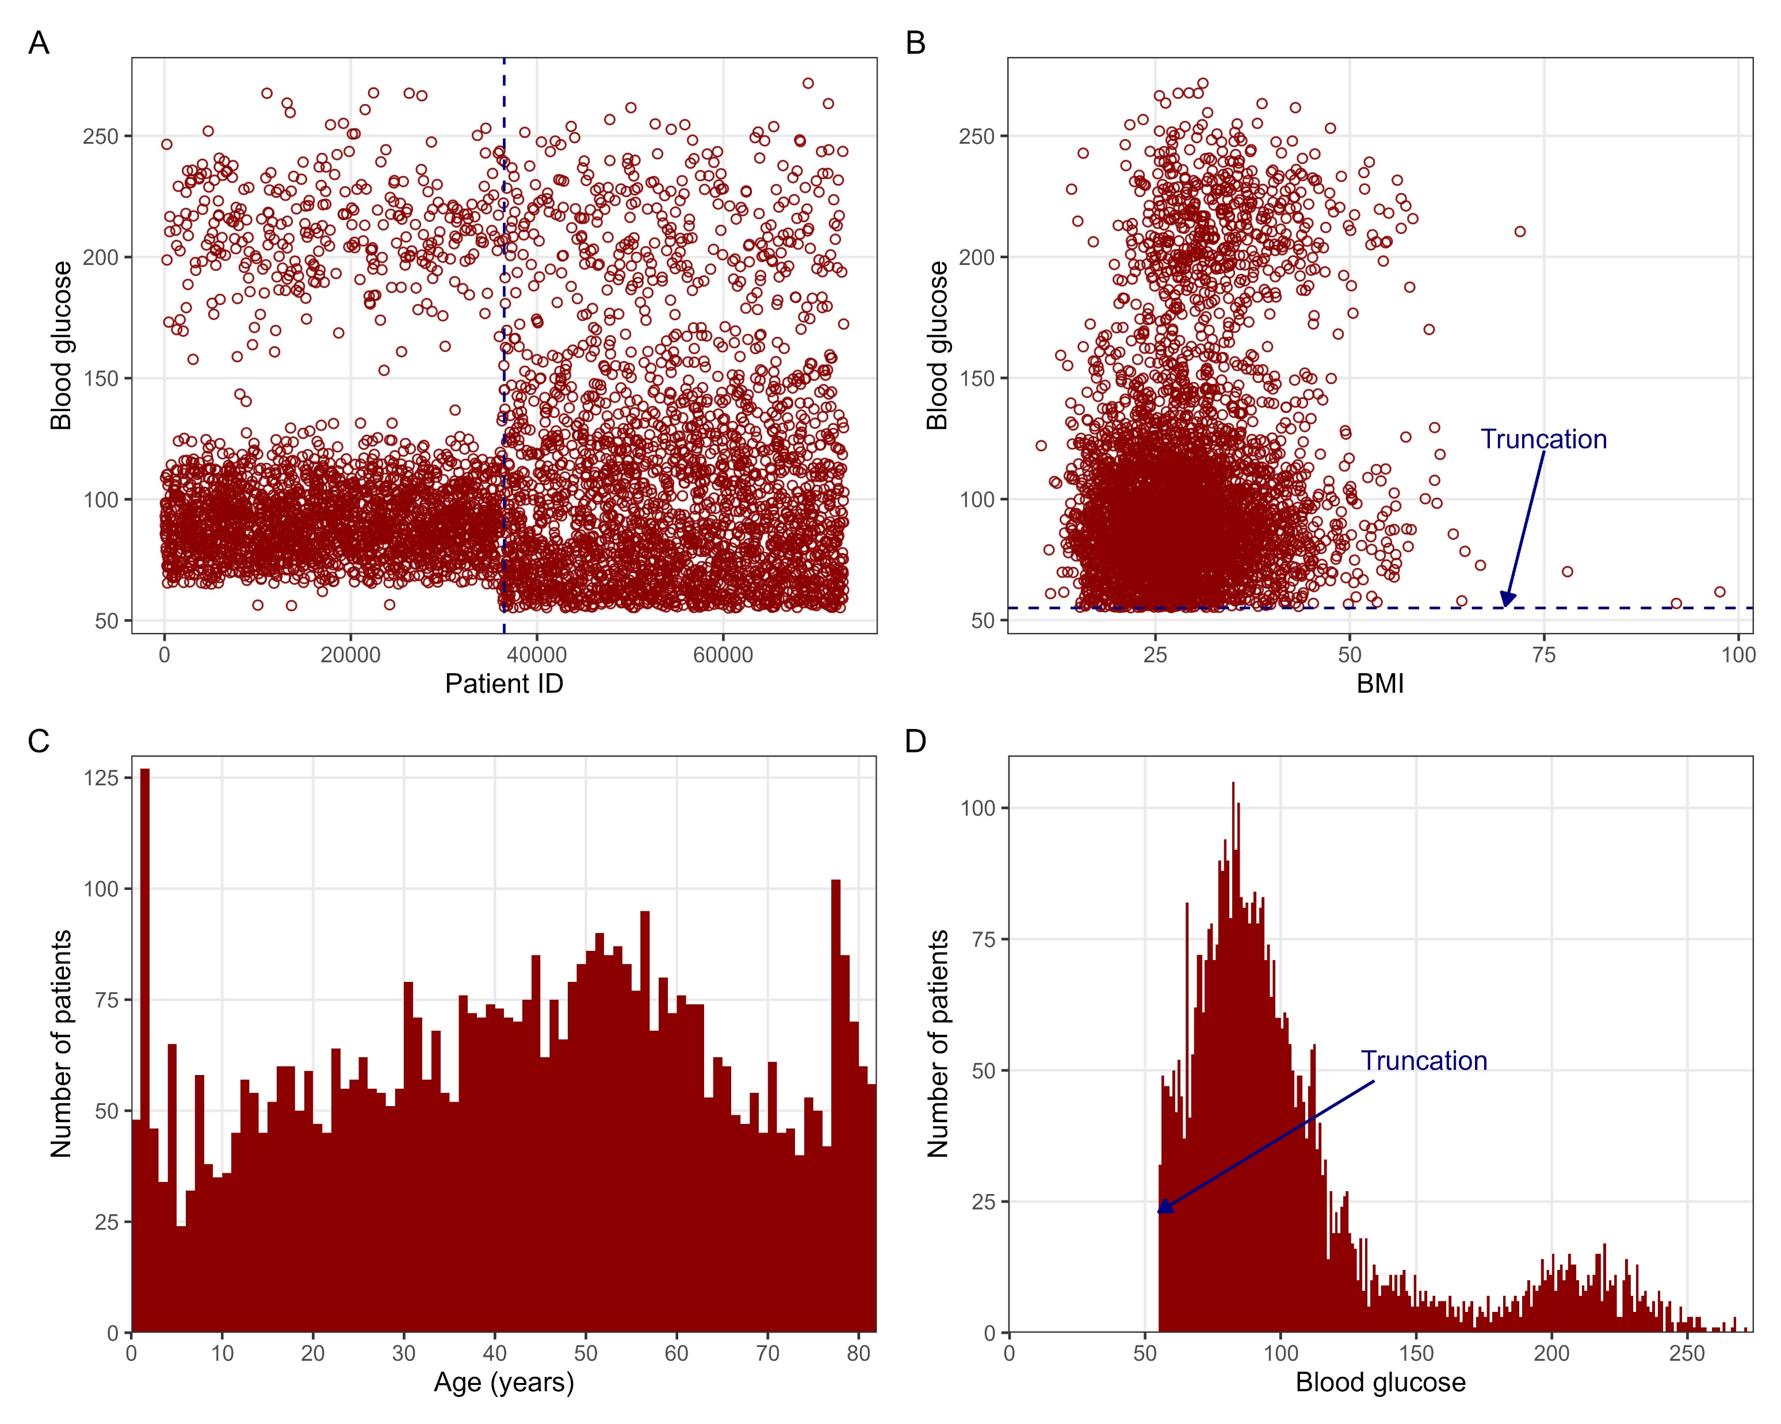
Stroke Dataset

Slide 19
– Graham Walker MD Founder of MDCalc

Slide 20
“Every single gatekeeper failed here. The repository didn't require provenance. The modelers didn't check the data. The reviewers didn't check the modelers. The review-article authors didn't check the reviewers. Each layer assumed the previous one had done the work. 𝗡𝗼𝗯𝗼𝗱𝘆 𝗱𝗶𝗱”
– Graham Walker MD Founder of MDCalc

Slide 21
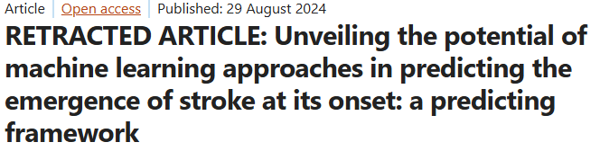
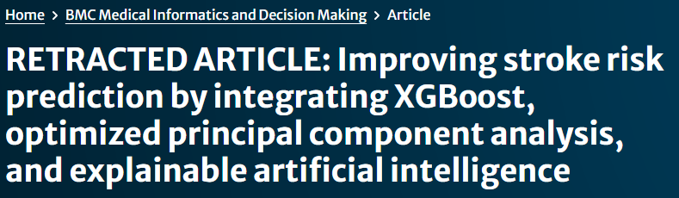
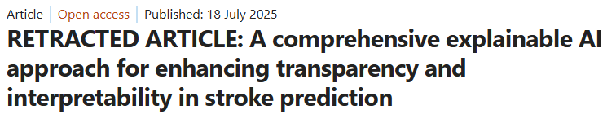
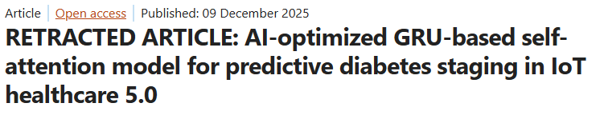
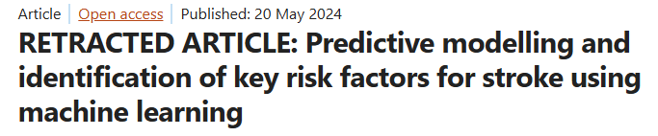
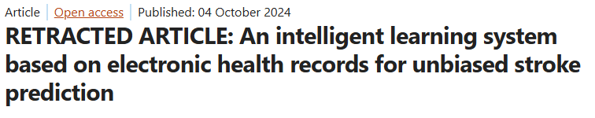
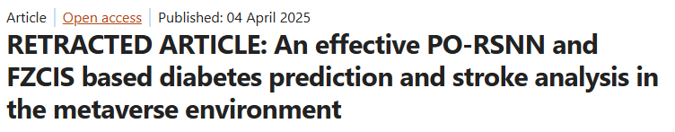

Slide 22
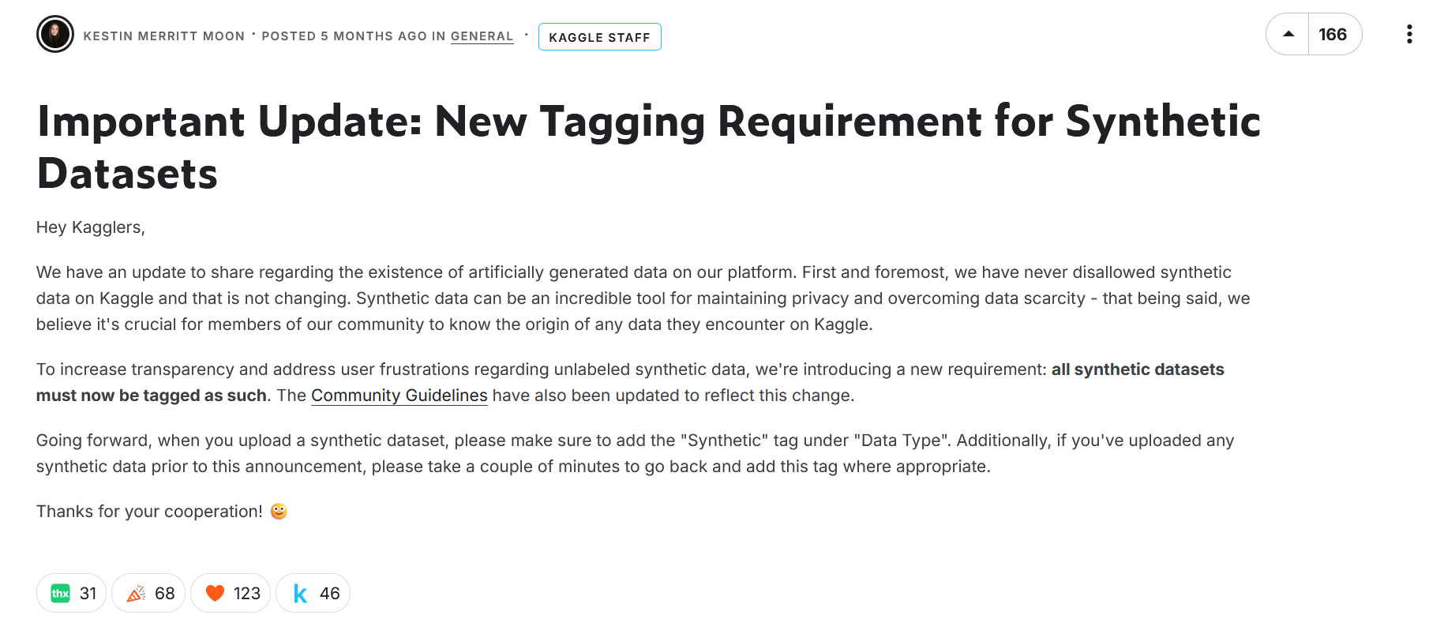
https://www.kaggle.com/discussions/general/679960

Slide 23
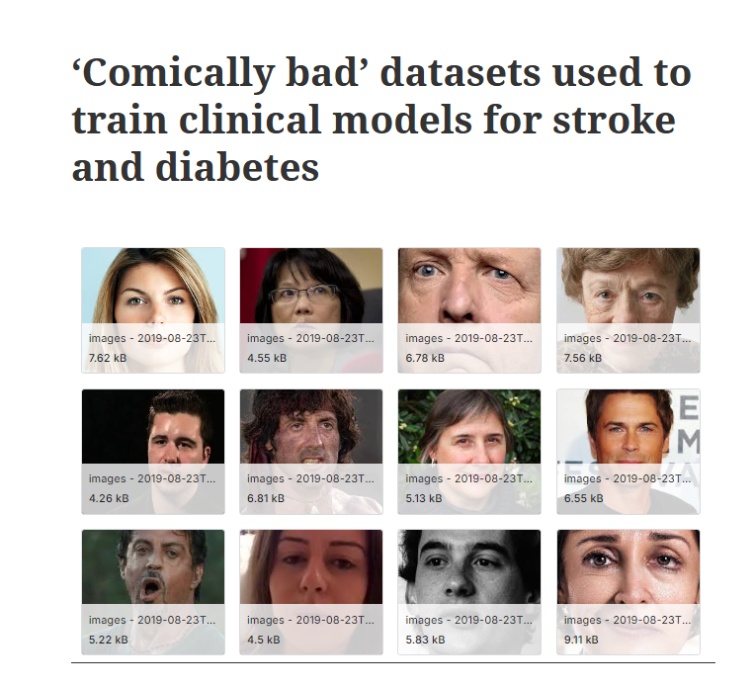

https://tinyurl.com/a7v27ymt

Slide 24
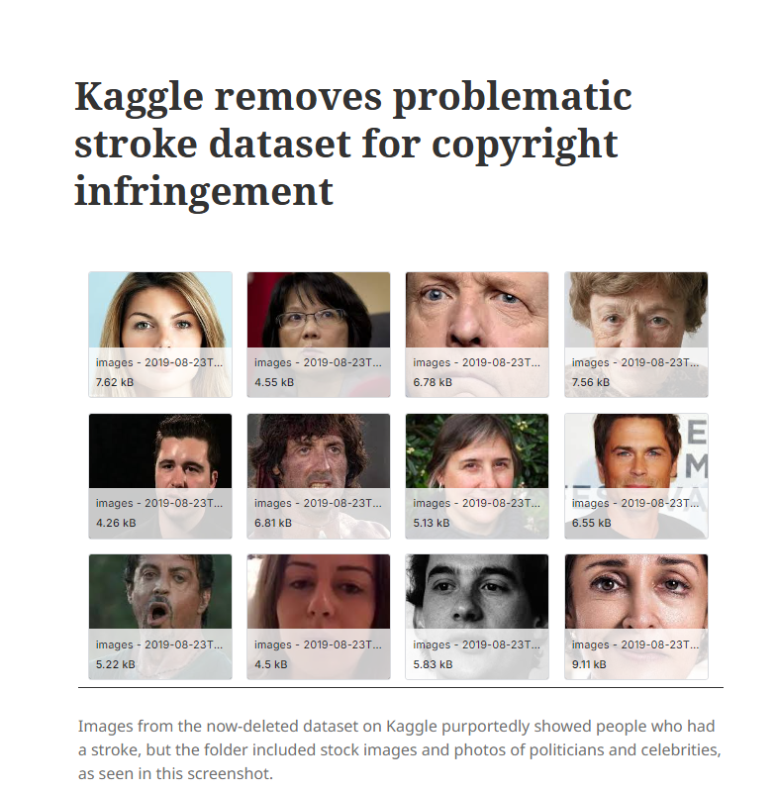

https://tinyurl.com/3zntmxk2

Slide 25


https://tinyurl.com/48fvkzvw

Slide 26
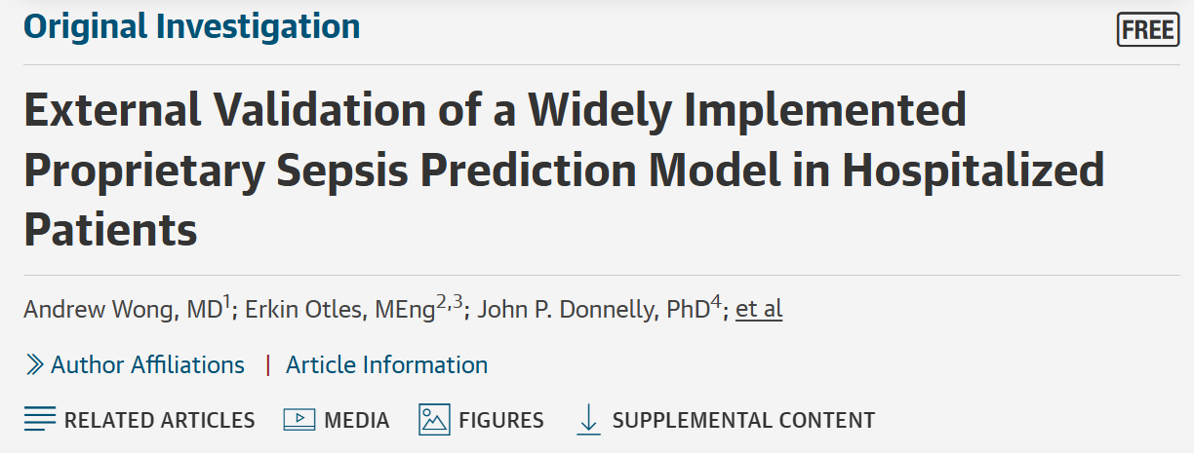
The EPIC Sepsis Model

Slide 27
The EPIC Sepsis Model
Implemented in 100’s of US hospitals nationally

Slide 28
The EPIC Sepsis Model
Implemented in 100’s of US hospitals nationally
Proprietary model

Slide 29
The EPIC Sepsis Model
Implemented in 100’s of US hospitals nationally
Proprietary model
Independent external validated on ~28,000 patients

Slide 30
The EPIC Sepsis Model
Implemented in 100’s of US hospitals nationally
Proprietary model
Independent external validated on ~28,000 patients
2 out 3 patients with sepsis were NOT identified

Slide 31
The EPIC Sepsis Model
“Our study has important national implications. The increase and growth in deployment of proprietary models has led to an underbelly of confidential, non–peer-reviewed model performance documents that may not accurately reflect real-world model performance. Owing to the ease of integration within the EHR and loose federal regulations, hundreds of US hospitals have begun using these algorithms. Medical professional organizations constructing national guidelines should be cognizant of the broad use of these algorithms and make formal recommendations about their use.”

Slide 32
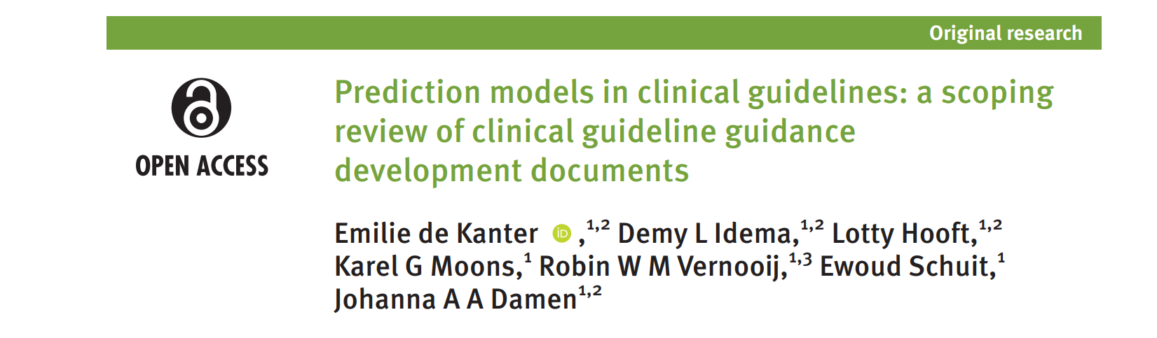
10.1136/ bmjebm-2025-114164
“?/84 of identified guidance documents included guidance regarding including and apprising prediction models in clinical guideline development.”

Slide 33
10.1136/ bmjebm-2025-114164
“8/84 of identified guidance documents included guidance regarding including and apprising prediction models in clinical guideline development.”

Slide 34
10.1136/ bmjebm-2025-114164
“none of them provided comprehensive guidance for all steps.”

Slide 35
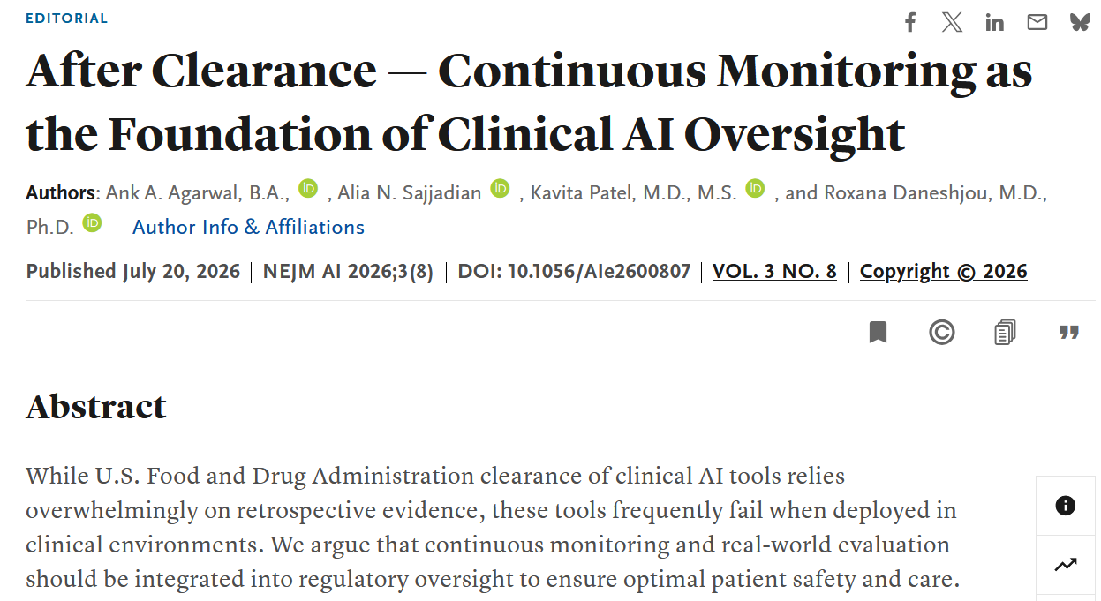
https://ai.nejm.org/doi/full/10.1056/AIe2600807

Slide 36
81% of the AI tools performed worse on external datasets.
https://ai.nejm.org/doi/full/10.1056/AIe2600807

Slide 37
81% of the AI tools performed worse on external datasets.
43% of AI device recalls happen within the first 12 months of clearance
https://ai.nejm.org/doi/full/10.1056/AIe2600807

Slide 38


Slide 39
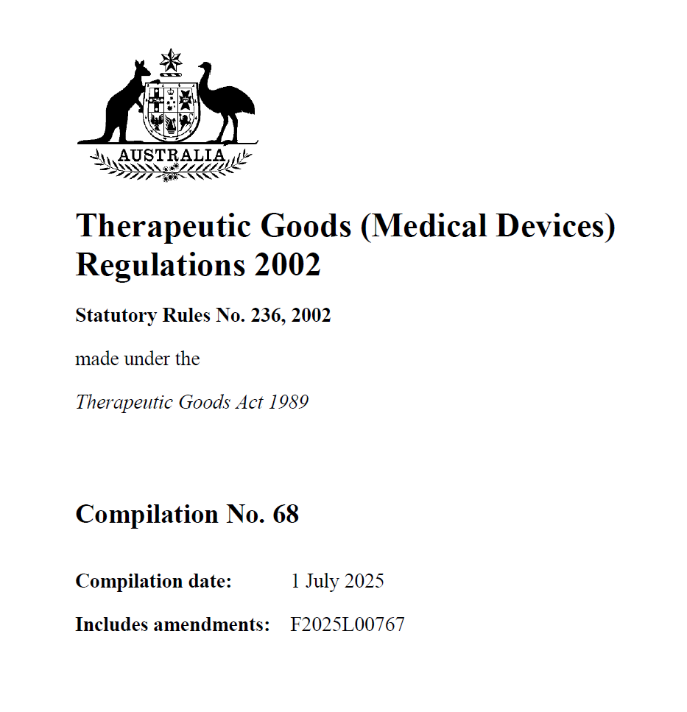
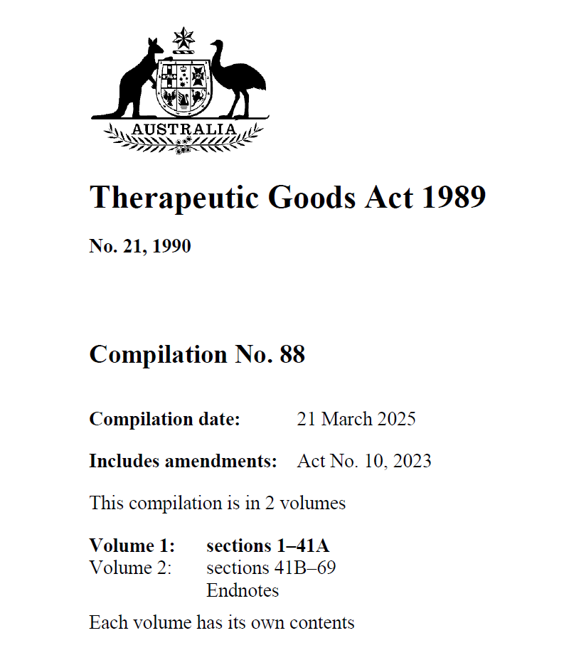

Slide 40
Updated in 2021 to include Software as Medical Devices

Slide 41
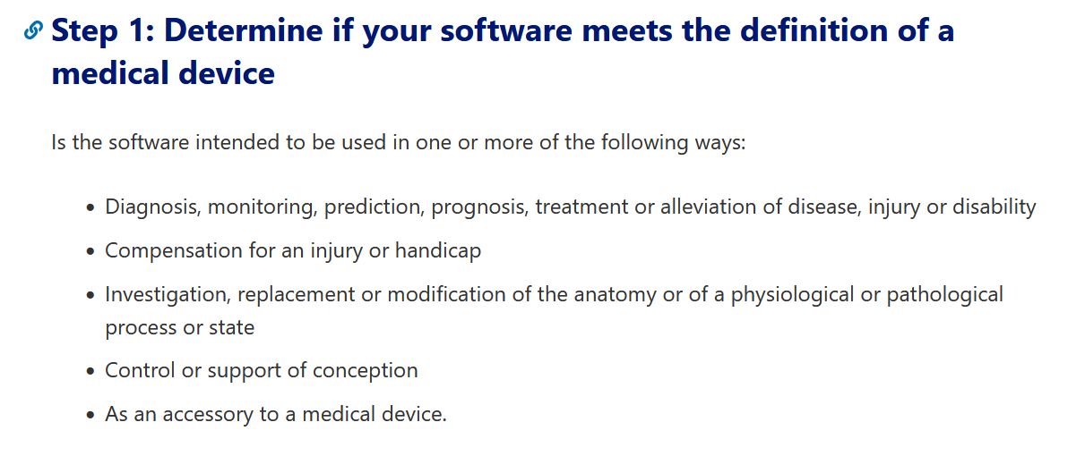

Software as Medical Device
https://tinyurl.com/2u5y8p67

Slide 42
Software as Medical Device Examples
Excluded (not regulated)
  Electronic Health Record Software & Communications Software
https://www.tga.gov.au/resources/guidance/understanding-clinical-decision-support-system-software-regulation

Slide 43
Software as Medical Device Examples
Excluded (not regulated)
  Electronic Health Record Software & Communications Software
Exempt (regulated)
  Digital clinical scoring tool, Thromboembolism risk assessment tool, integrated ICU tool flagging clinical parameters
https://www.tga.gov.au/resources/guidance/understanding-clinical-decision-support-system-software-regulation

Slide 44
Software as Medical Device Examples
Excluded (not regulated)
  Electronic Health Record Software & Communications Software
Exempt (regulated)
  Digital clinical scoring tool, Thromboembolism risk assessment tool, integrated ICU tool flagging clinical parameters
Non-Exempt (regulated)
  Tool directly diagnoses diabetes, software flags recommendation after a threshold is reached, tool calculates probability of infant having chromosomal abnormality
https://www.tga.gov.au/resources/guidance/understanding-clinical-decision-support-system-software-regulation

Slide 45
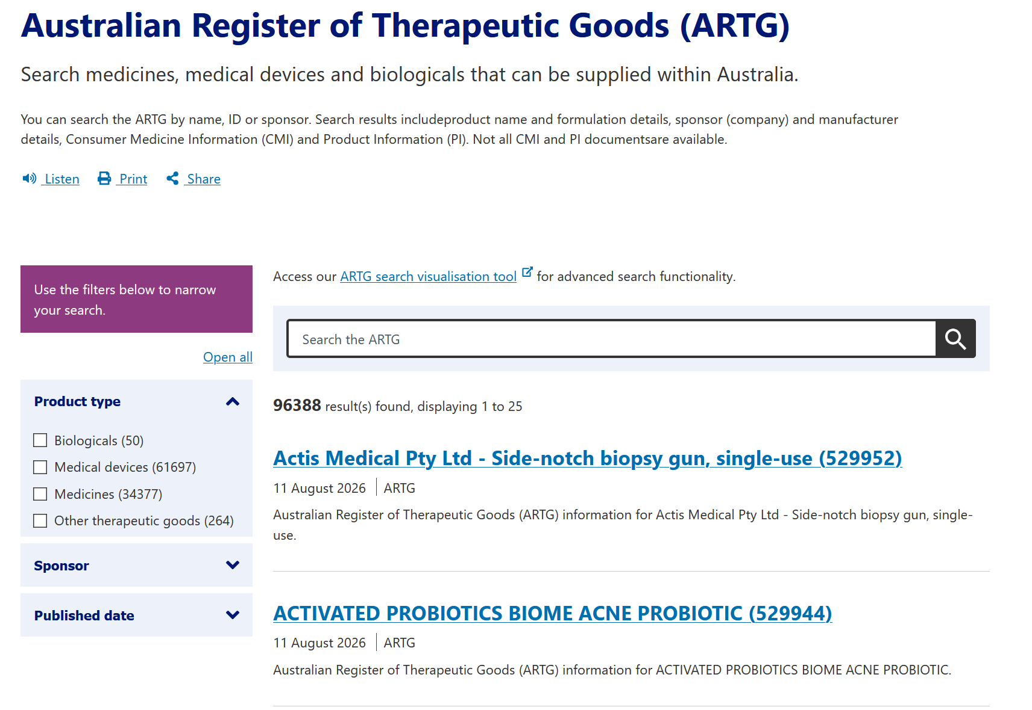

Australian Register of Therapeutic Goods
https://www.tga.gov.au/resources/artg

Slide 46
Australian Register of Therapeutic Goods
Excluded devices are not regulated by the TGA

Slide 47
Australian Register of Therapeutic Goods
Excluded devices are not regulated by the TGA
Exempt & non-exempt devices need to comply with 15 essential principles (clinical evidence, adverse reporting etc)

Slide 48
Australian Register of Therapeutic Goods
Excluded devices are not regulated by the TGA
Exempt & non-exempt devices need to comply with 15 essential principles (clinical evidence, adverse reporting etc)
Exempt devices notify TGA within 30 days of supply

Slide 49
Australian Register of Therapeutic Goods
Excluded devices are not regulated by the TGA
Exempt & non-exempt devices need to comply with 15 essential principles (clinical evidence, adverse reporting etc)
Exempt devices notify TGA within 30 days of supply
Non-exempt devices included on the ARTG

Slide 50
Australian Register of Therapeutic Goods
Excluded devices are not regulated by the TGA
Exempt & non-exempt devices need to comply with 15 essential principles (clinical evidence, adverse reporting etc)
Exempt devices notify TGA within 30 days of supply
Non-exempt devices included on the ARTG
“…we do not maintain a list of products that qualify for general exemptions from inclusion in the Register.” – TGA

Slide 51
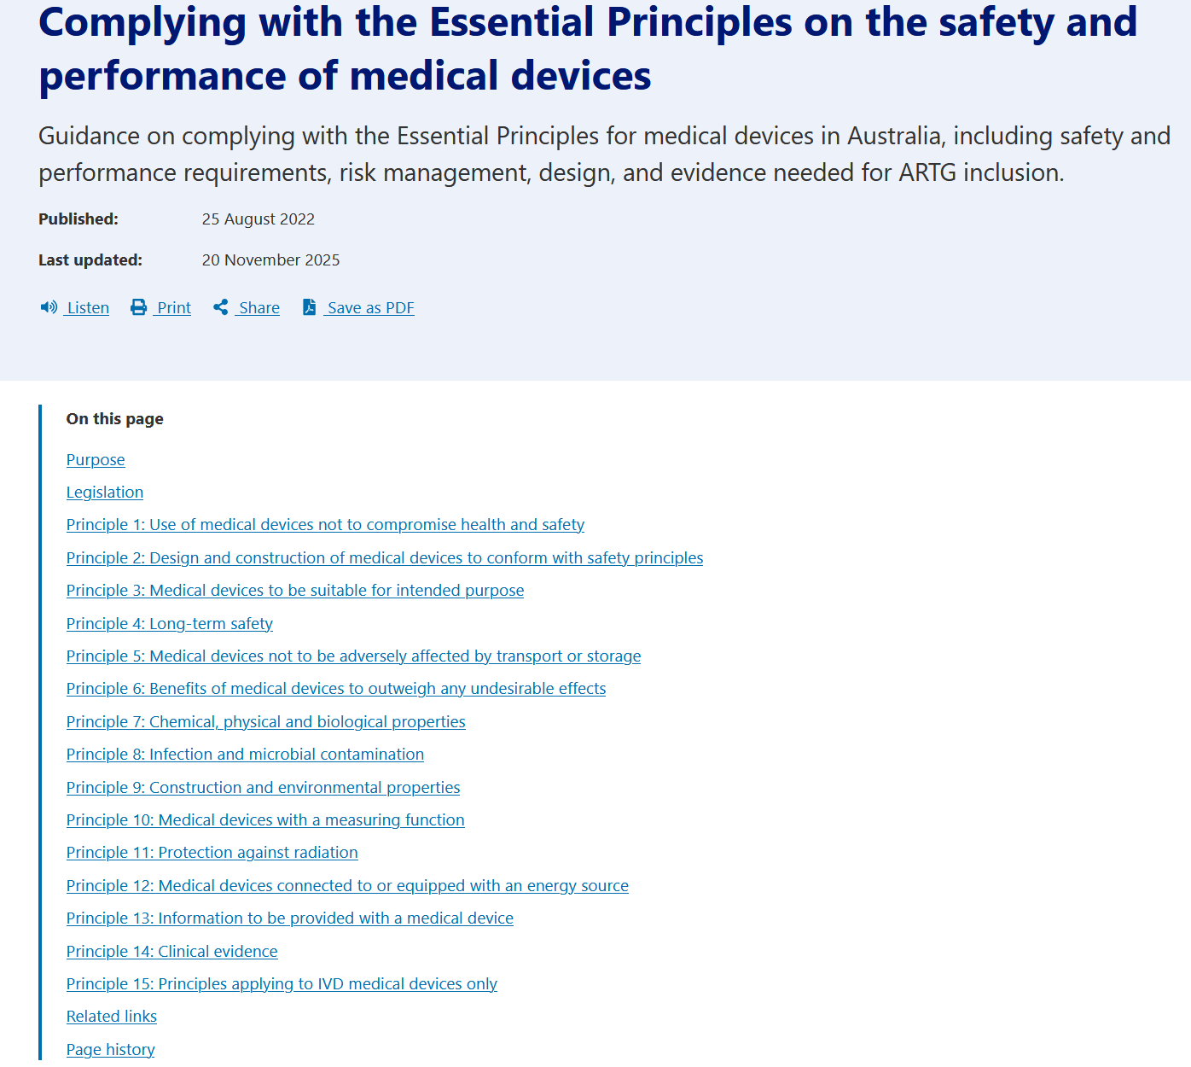

Slide 52
Unfortunate Summary
Prediction models are unknowingly being developed on synthetic data
Prediction models are not appropriately implemented into guidelines
81% of FDA cleared models perform worse on external data
“Underbelly” of proprietary models
TGA do not track exempt devices, those that should regulated, may not be

Slide 53
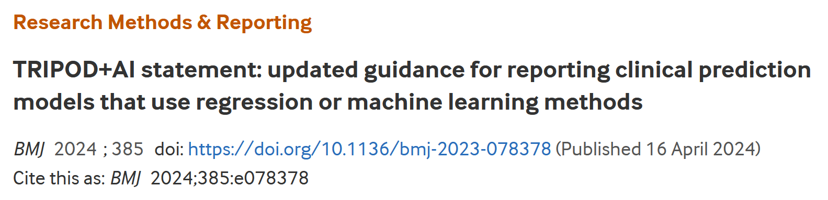
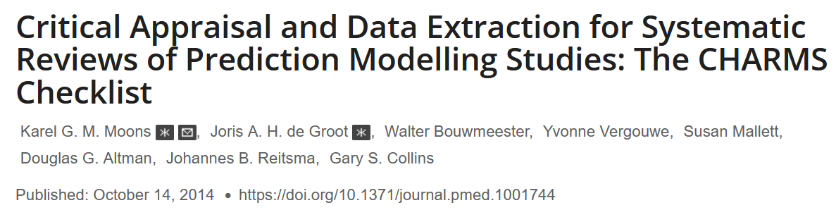
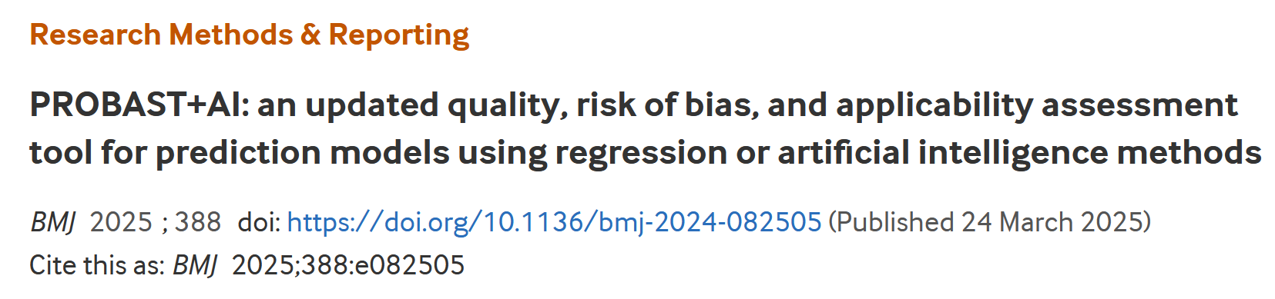
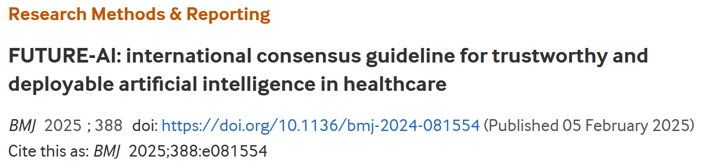
What to do?

Slide 54


What to do?

Slide 55
What to do?
More evidence
Better reporting
Better implementation & adoption
Continuous monitoring & updating

Slide 56
Questions?
www.alexdgibson.com ad.gibson@hdr.qut.edu.au

